Slide 1
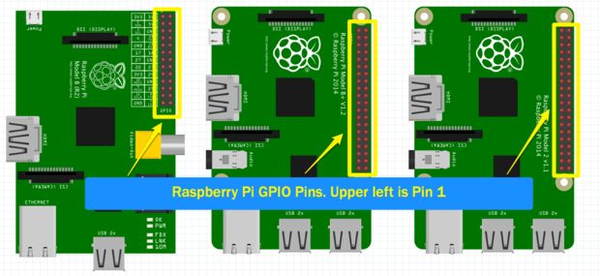
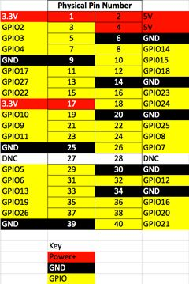

Slide 2
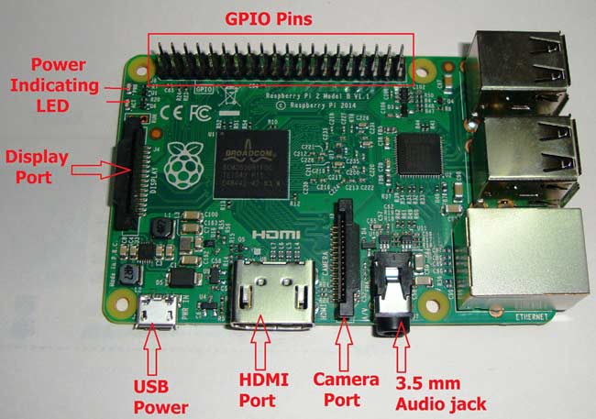

Slide 3
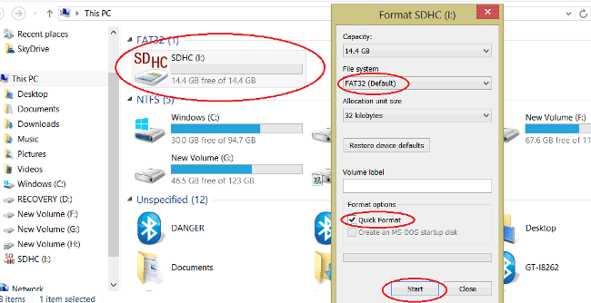

Slide 4
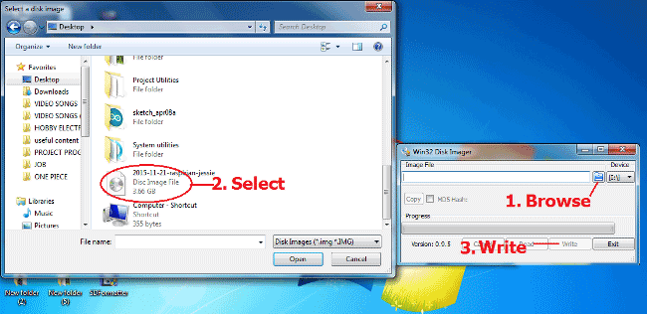

Slide 5
Python
Programmers use Python to create things like:
Web applications
Desktop applications and utilities
Special GUIs
Small databases
2D games

Slide 6
Python
To begin, enter sudo nano hello-world.py at the command prompt to open the nano text editor and create a new file named hello-world.py.
Enter this code into nano, then press Ctrl-X to exit and save the file:
All Python program files will need to be saved as “.py” file types.
To run the program without making it executable, navigate to the location where you saved your file, and type python hello-world.py
We can make the hello-world.py file executable by entering chmod +x hello-world.py at the command prompt. Now, all we need to do to run the program is enter: ./hello-world.py.

Slide 7
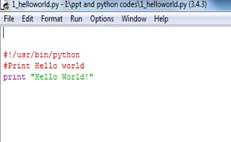

Slide 8
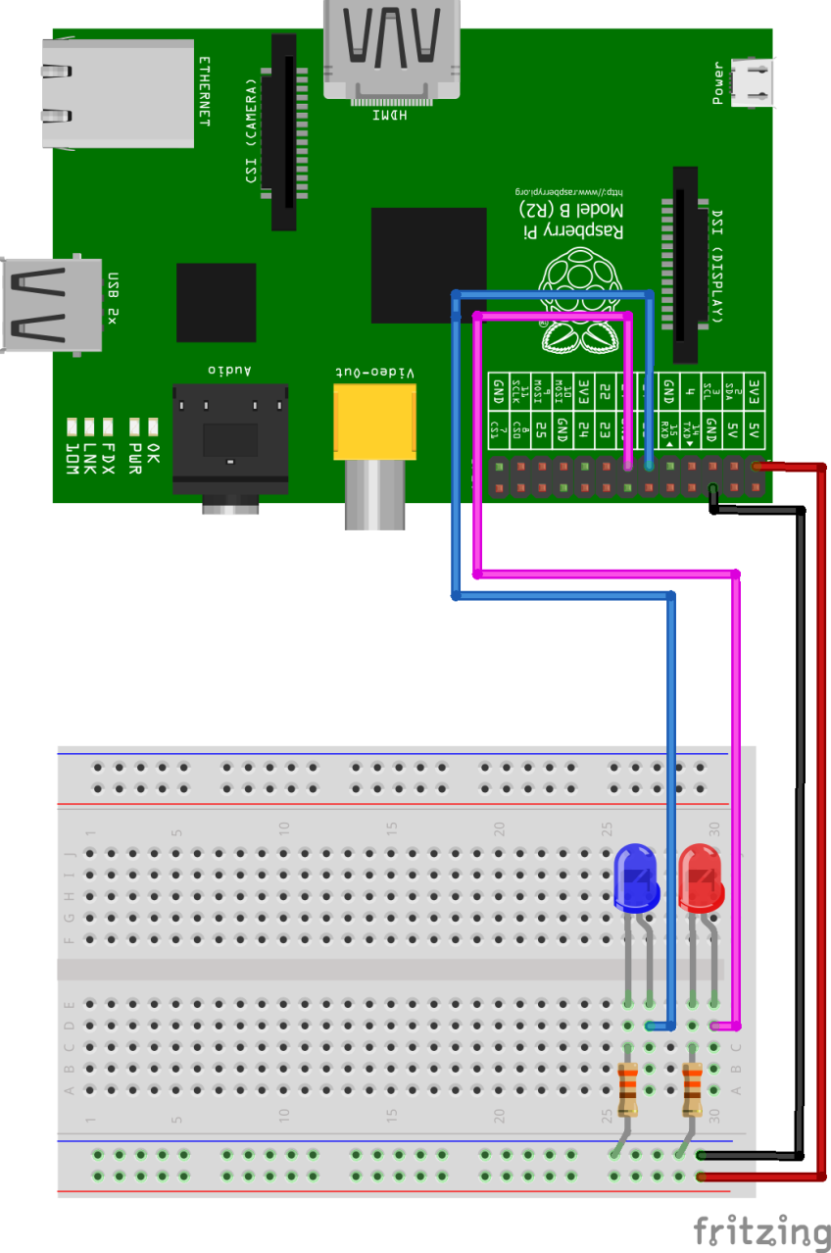

Slide 9
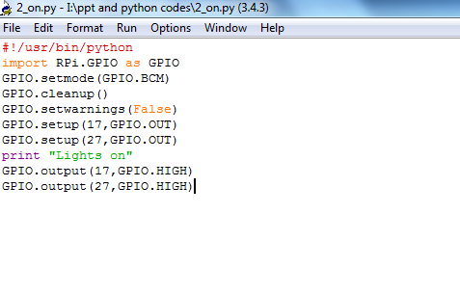

Slide 10
TURN OFF THE LEDS “LED_off.py”
#!/usr/bin/python
import RPi.GPIO as GPIO
GPIO.setmode(GPIO.BCM)
GPIO.cleanup()
GPIO.setwarnings(False)
GPIO.setup(17,GPIO.OUT)
GPIO.setup(27,GPIO.OUT)
print "Lights on"
GPIO.output(17,GPIO.LOW)
GPIO.output(27,GPIO.LOW)

Slide 11
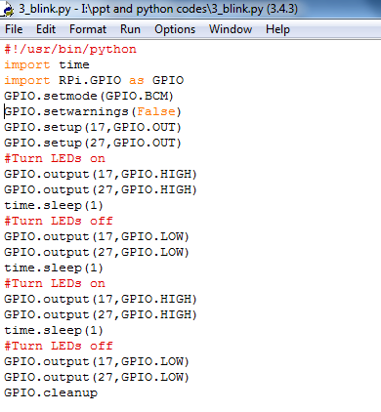

Slide 12
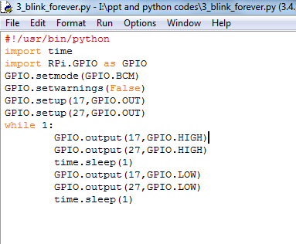

Slide 13
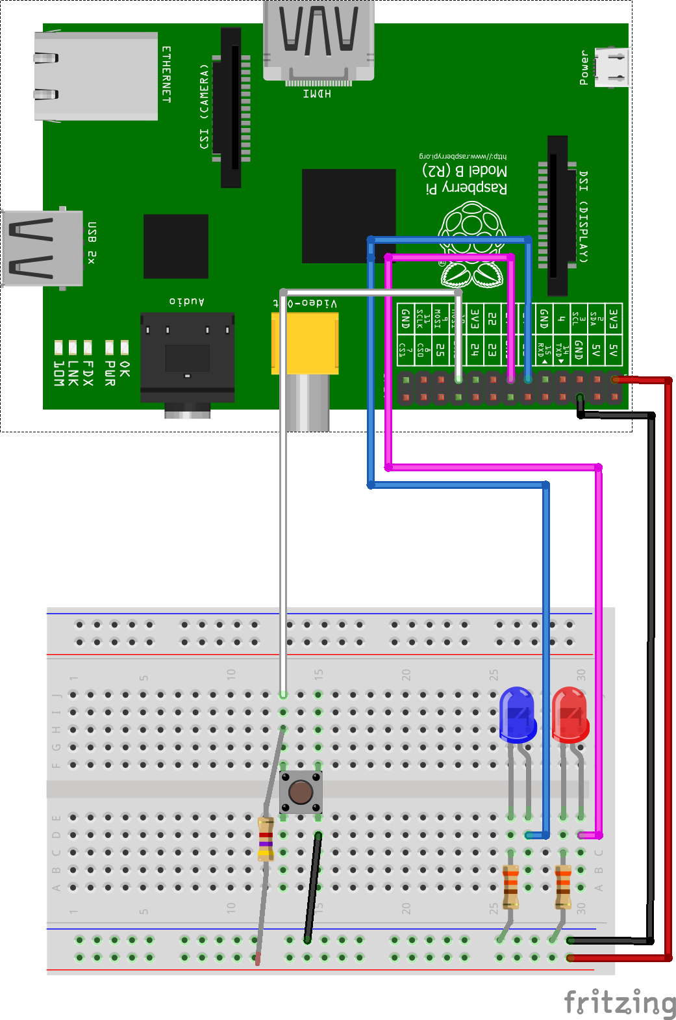

Slide 14
#!/usr/bin/python
import time
import RPi.GPIO as GPIO
GPIO.setmode(GPIO.BCM)
GPIO.setwarnings(False)
GPIO.setup(10, GPIO.IN)
GPIO.setup(17,GPIO.OUT)
print GPIO.input(10)
while True:
if ( GPIO.input(10) == True ):
GPIO.output(17,GPIO.HIGH)
else:
GPIO.output(17,GPIO.LOW)
print ("Waiting for you to press a button")
time.sleep(1)

Slide 15
#!/usr/bin/python
import os
import time
import RPi.GPIO as GPIO
GPIO.setmode(GPIO.BCM)
GPIO.setwarnings(False)
GPIO.setup(10, GPIO.IN)
print GPIO.input(10)
while True:
if ( GPIO.input(10) == False ):
print("Button Pressed")
os.system('date')
print GPIO.input(10)
time.sleep(5)
else:
os.system('clear')
print ("Waiting for you to press a button")
time.sleep(1)

Slide 16
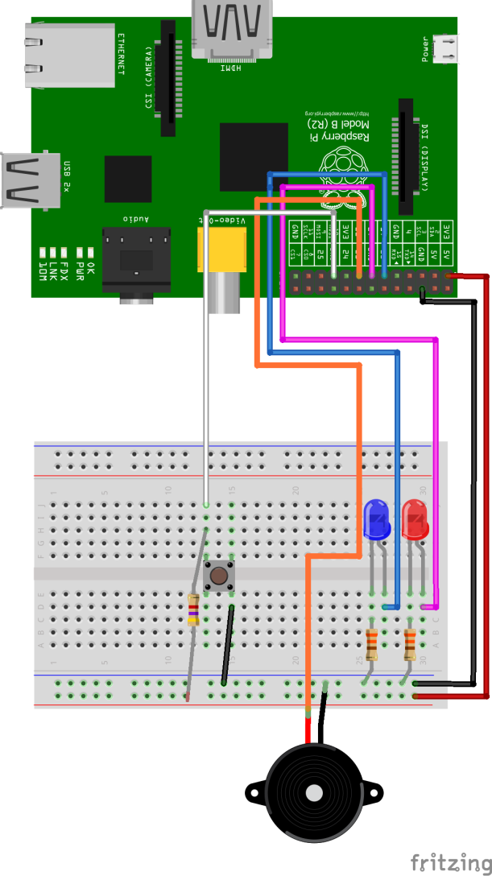

Slide 17
import os
Import time
Import Rpi.GPIO as GPIO
GPIO.setmode(GPIO.BOARD)
GPIO.setwarnings(False)
GPIO.setup(3,GPIO.OUT)
GPIO.setup(5,GPIO.IN)
while true:
if (GPIO.input(5)==True):
GPIO.output(3,GPIO.HIGH)
time.sleep(.5)
GPIO.output(3,GPIO.HIGH)
time.sleep(.5)

Slide 18
#!/usr/bin/python
import os
import time
import RPi.GPIO as GPIO
GPIO.setmode(GPIO.BCM)
GPIO.setwarnings(False)
GPIO.setup(22,GPIO.OUT)
loop_count = 0
def buzzer ():
GPIO.output(22,GPIO.HIGH)
time.sleep(.1)
GPIO.output(22,GPIO.LOW)
time.sleep(.1)

Slide 19
os.system('clear')
print “Buzzer"
loop_count = input("How many times would you like SOS to loop?: ")
while loop_count > 0:
loop_count = loop_count - 1
buzzer ()

Slide 20
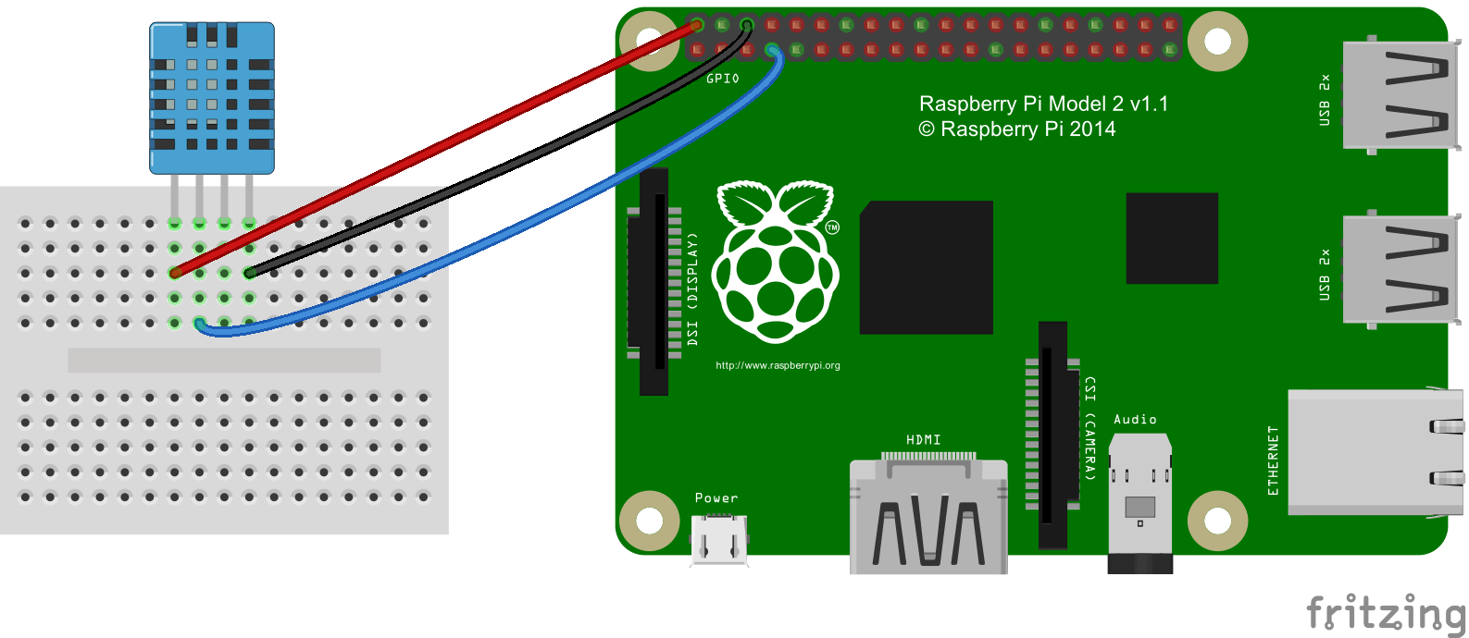

Slide 21
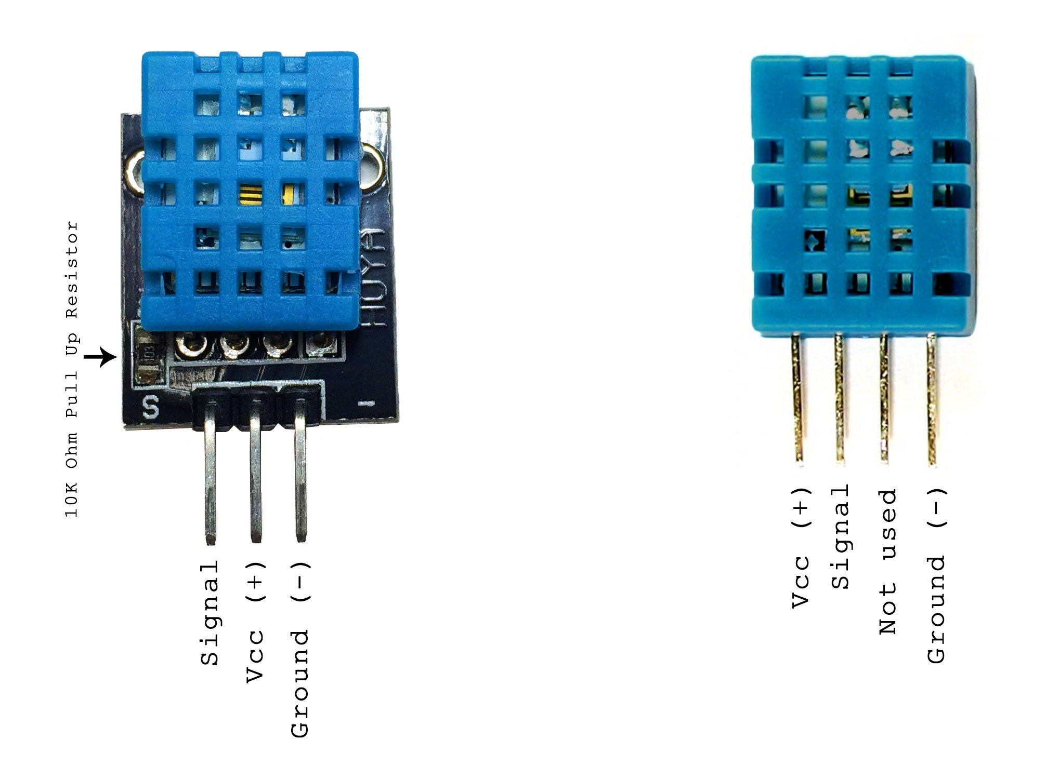

Slide 22
We will use Adafruit's library for setting up Python to communicate with the Raspberry Pi GPIO pins
sudo apt-get update
To install RPi.GPIO, you first need to install the Python Development toolkit that RPi.GPIO requires.
To do this enter the following command into LXTerminal:
sudo apt-get install python-dev
Then to install Rpi.GPIO itself type:
sudo apt-get install python-rpi.gpio
You will probably be prompted to confirm by entering 'Y'.

Slide 23
Download the Adafruit DHT11 Python Library using Git:
enter this at the command prompt:
sudo apt-get install git-core
Note: If you get an error installing Git, run sudo apt-get update
and try it again.
To install the Adafruit DHT11 library:
Enter this at the command prompt to download the library:
git clone https://github.com/adafruit/Adafruit_Python_DHT.git
2. Change directories with:
cd Adafruit_Python_DHT

Slide 24
3. Enter this:
sudo apt-get install build-essential python-dev
4. Install the library with:
sudo python setup.py install

Slide 25
Output to an SSH Terminal
#!/usr/bin/python
import sys
import Adafruit_DHT
while True:
humidity, temperature = Adafruit_DHT.read_retry(11, 4)
print 'Temp: {0:0.1f} C Humidity: {1:0.1f} %'.format(temperature ,humidity)

